Slide 1
2017 VVV Reunion
Crockett Hotel
San Antonio, Texas

Slide 2
The opening meeting at the Crockett Hotel Jordan Johnston, Darren Welch and Michelle Alexander

Slide 3
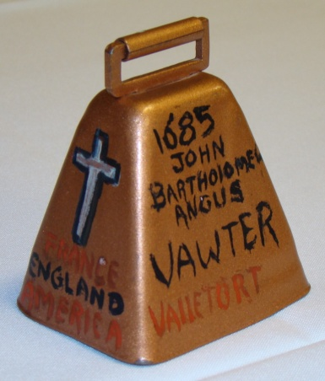
The bell ringer Stafford Cummings
A family tradition

Slide 4
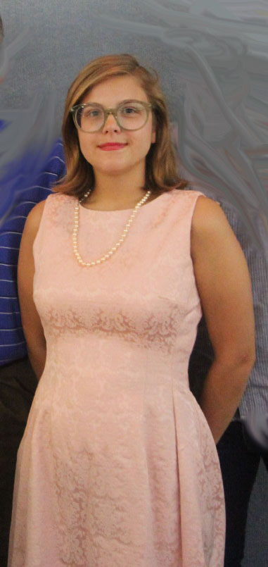
Anna Welch led the Pledge of Allegiance

Slide 5
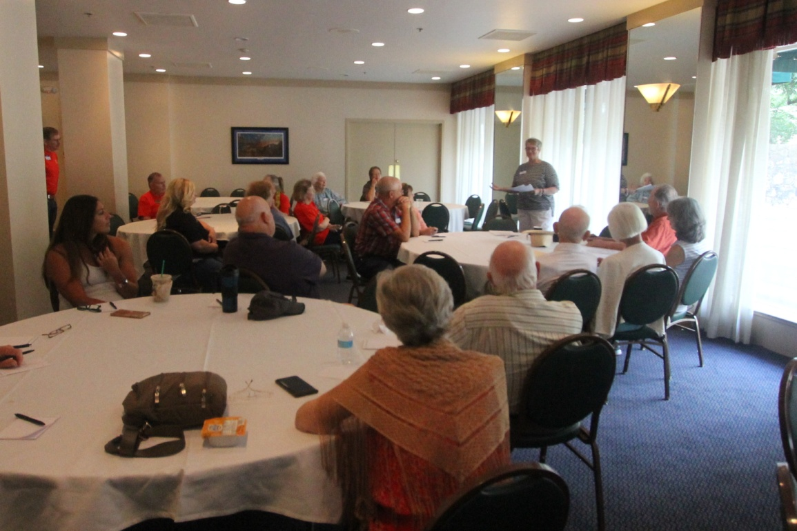
VVV genealogist Georgene Jurgensen gave a presentation about the family in Texas

Slide 6
Stafford, Fredrick, Cullen and Rebecca Cummings, George Wicker, Fred Wicker, Kellee and McDaniel Wicker, Ken Wicker Front row: Rebecca Cummings, Ellen Cummings and Norma Wicker

Slide 7
Tommy and Kathryn Moore

Slide 8
Richard Howard, Beth Melton, Beverly Cowan and Kyle Cowan

Slide 9
Ray Vaughters, Dorothy Keeton, Patti Ream and Terry Luton

Slide 10
Terri and Dale Crawley

Slide 11
Paul, Connie and Chad Bugos

Slide 12
Martha Hudson, Alissa Hale, Chris Hale and Hayden Hale

Slide 13
Shirley and Jerry Beasley, Michelle, Reba and Michael Alexander, Linda and Jason Vawter and Lilah in front

Slide 14
Jason Williams, Sandra and Jordan Johnston, Patricia Renton, Marcus Johnston, Sidra Myers, Daria Williams in front: Joshua, Joseph and Luke Williams

Slide 15
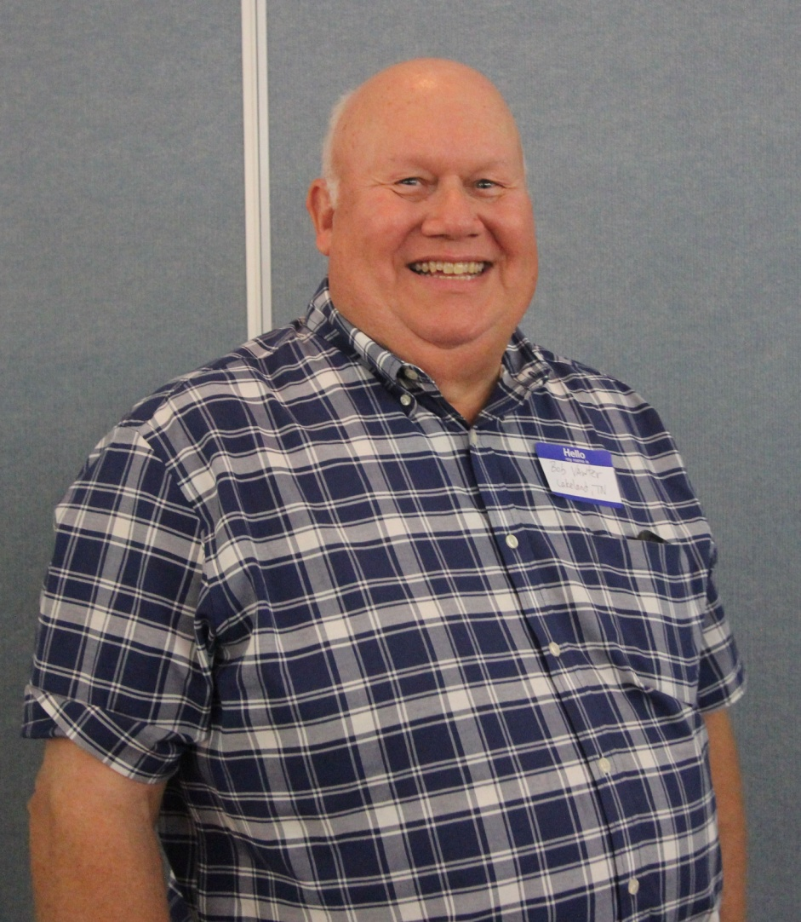
Robert L (Bob) Vawter Sharon and B. Ray Mize

Slide 16
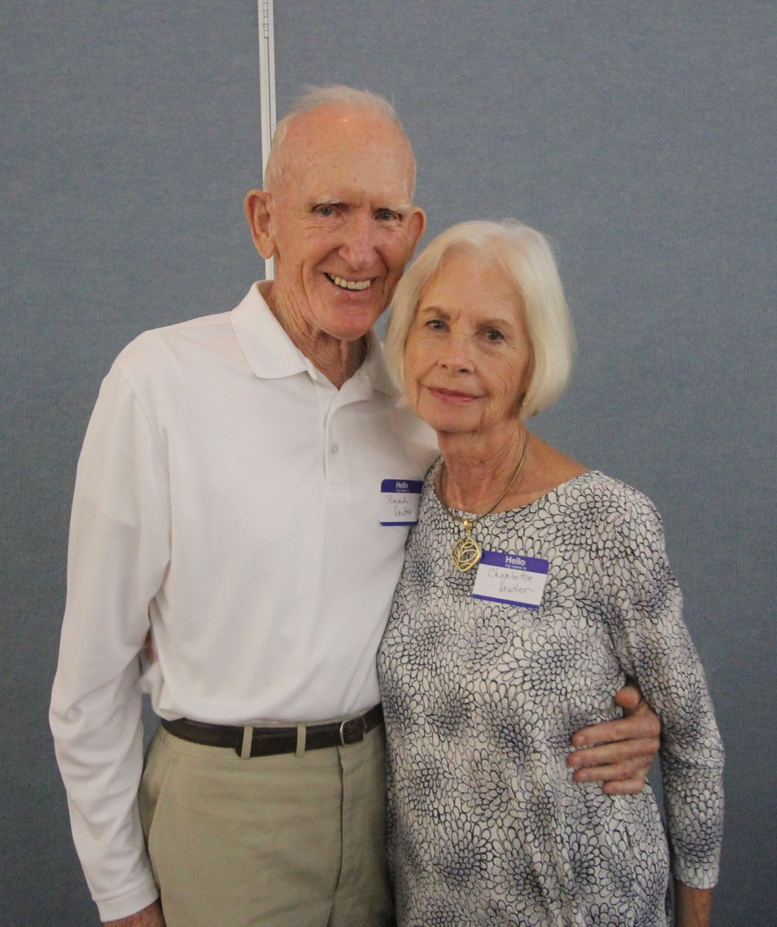
Read and Charlotte Vawter Georgene Jurgensen

Slide 17
Matthew, Brenda and Michael McNary

Slide 18
Danny Chaviers, Ranee Chaviers (holding Maceyn), Andrew Blackwell, Renae Chaviers, Kailey Blackwell, Stephanie Blackwell, Cindy Landry (holding Ellie), Melinda Vawter. In front: Sue Vawter, Morgan, Coco and Skylar

Slide 19
Alexander Hatori, Will Marsh, Zoe Vaughter, Mike MacDonald, Courtney MacDonald, Aubreigh Marsh and Phil Vaughter

Slide 20
Bonita, Darren, Anna and Will Welch

Slide 21
The Menger Hotel served a luscious buffet of Mexican food and after we ate, VVV President Darren Welch opened the evening program

Slide 22
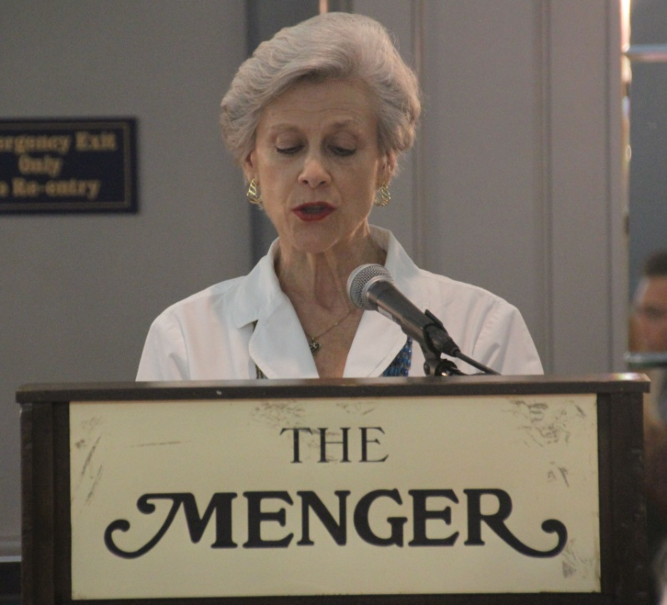
The memorial service, by Fred Wicker, Ellen Cummings and Michelle Alexander

Slide 23
Jerry and Shirley Beasley were in charge of the door prizes and the auction to raise money for the Vauter Church.

Slide 24
Georgene brought a beautiful homemade quilt for the auction.

Slide 25
Bonita and Anna invited us to the reunion in Madison, Indiana in July 2018

Slide 26
The Alamo was one of the main attractions in downtown San Antonio. Cousins also visited Sea World, the River Walk, “The Pearl” and many other interesting places.

Slide 27
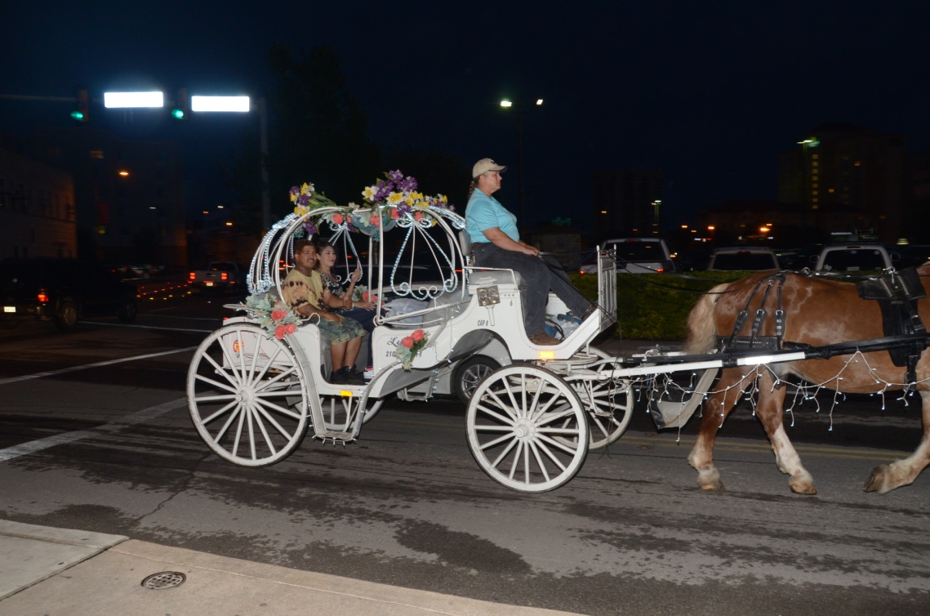
And the sound of clippety-clop way into the night.

Slide 28
Thank you, Michael McNary and Bob Vawter
For sending in the photos.

